Slide 1

Data Analytics in Action: Evaluating Key Predictors of Sleep Outcomes
A Use Case in Digital Behavior Analysis
Mark Dormeier, Student Analyst
May 1, 2025
Notes:
Hello, everyone. Thank you for being here today. I'm Mark, a student analyst, and I'm excited to discuss sleep quality in the digital age. My presentation is "Data Analytics in Action: Evaluating Key Predictors of Sleep Outcomes." We'll examine how excessive screen time and blue light disrupt our natural sleep patterns, affecting our thinking and increasing stress. We'll also look at how lifestyle choices impact sleep. Our findings suggest ways to improve sleep habits. Let's explore how our daily habits affect our sleep quality and well-being.

Slide 2

Analytical Thesis
Increased screen time disrupts sleep quality, with additional effects from physical activity and environmental factors.
Excessive screen time disrupts sleep by affecting melatonin levels, causing concentration issues and stress. This knowledge can help create programs for better sleep and healthier digital habits.
Notes:
In our investigation, we propose that excessive screen time, especially during the evening, is a significant factor contributing to disrupted sleep. The blue light from screens makes it harder for our bodies to produce melatonin, a hormone that helps control our sleep-wake cycles.

Slide 3
The Sleep Quality Problem
Problem Being Solved
Problem
Excessive screen time with blue light
Symptoms
Reduced focus
Increased stress
Other potential health risks.
Stops Melatonin Production
Problem
Lifestyle Factors Influencing Sleep
Symptoms
Physical Activity
2. Light Exposure
3. Demographics
Solution
Mitigating screen time before bed can help us all
fall asleep faster and sleep longer.
Notes:
The data suggests that excessive screen time and blue light impact sleep quality in the digital age, disrupt circadian rhythms, and pose health risks. The results suggest managing night-time screen exposure and incorporating regular exercise to improve sleep quality. Exposure to natural daylight and considering demographics like age and gender are essential for developing effective strategies to enhance sleep health.

Slide 4
child-mind-institute-problematic-internet-use (1) Dataset
Data Preparation: Clean data, handle missing values, and create meaningful features.
Technical Setup: Workstation with 16 GB+ RAM; Windows 10 Pro or macOS/Linux.
Tools: R 4.2.0, RStudio 2025.04
Packages: Random Forest, VIP, ggplot2.
Model: Random Forest for prediction and variable importance.
Visualization: VIP plots and customized ggplot2 charts
Notes:
In this slide, I'll summarize our analysis steps. We went with the ‘child-mind-institute-problematic-internet-use (1) Dataset’ for this entire project. We prepared and cleaned the data to ensure accuracy and created new features to enhance our insights. We used a Dell laptop running Windows 10 Pro, but similar tools work on macOS or Linux. Our analysis was primarily done in R version 4.2.0 with RStudio. Key packages included ‘Random Forest' for our predictive model, 'VIP' for feature visualization, and 'ggplot2' for creating charts. We chose a Random Forest model for its ability to handle complex data and reveal essential relationships. We analyzed how screen time impacts sleep outcomes by focusing on data cleaning, feature creation, model selection, and clear visuals.

Slide 5
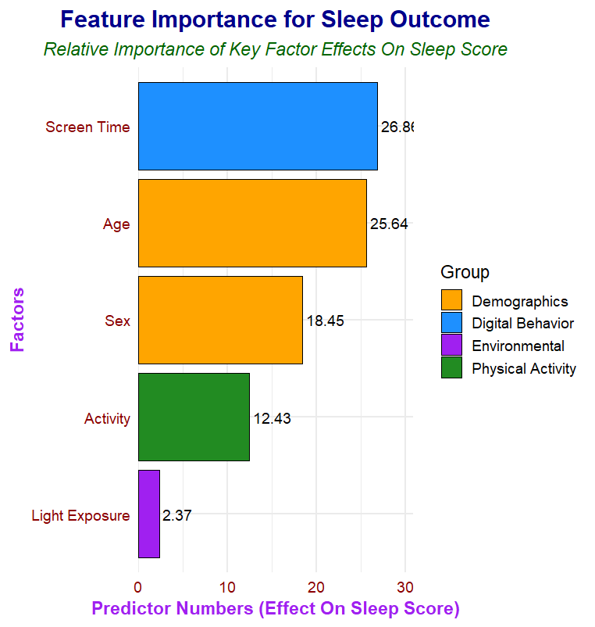
Results Summary
Screen Time: The main factor disrupting sleep quality.
Demographics: Age and sex influence sleep patterns. This shows that people need different strategies for better sleep.
Other Factors: Physical activity and light exposure are secondary influences.
Visualizations
Feature Importance Plot: A bar chart shows predictor importance with color-coded legends and numeric scores (0-30).
Scores: Clear labels highlight the impact of screen time.
Notes:
This slide presents the results of our Random Forest model used to predict sleep outcomes based on lifestyle factors. We selected Random Forest for its ability to model complex, non-linear relationships and provide variable importance measures. The feature importance plot shows that screen time has the highest predictive weight. Screen time disrupts sleep more than physical activity or light exposure. The analysis shows how digital behavior affects sleep quality and highlights the Random Forest model's effectiveness for actionable insights.

Slide 6
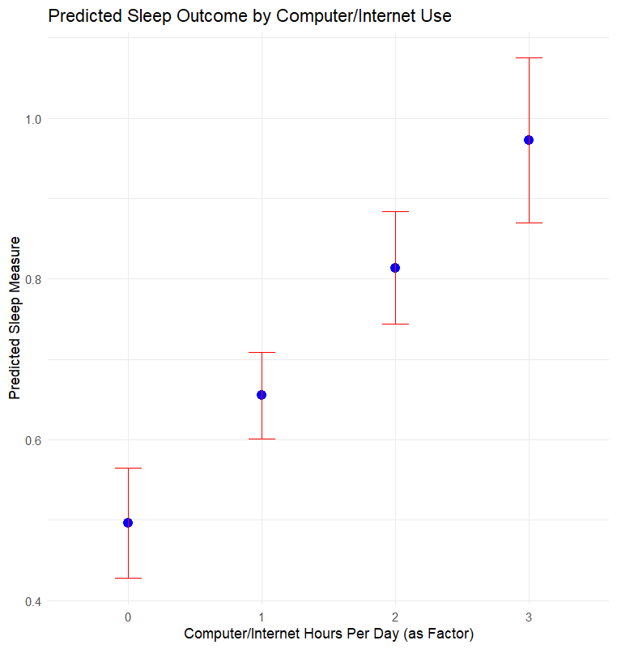
Coefficient Plot
(Dot & Whiskers Plot)
Screen Time and Sleep Quality
Usage Levels: Daily use (0-3 hours).
Predicted Sleep Scores:
0 hrs: ~0.6
1 hr: ~0.75
2 hrs: ~0.85
3 hrs: ~1.0
Results
More screen time may correlate with changes in sleep quality. Higher scores can indicate either better engagement or poorer sleep quality.
Notes:
This slide examines the relationship between daily screen time and predicted sleep quality, as visualized by our coefficient plot. The horizontal axis represents daily screen time measured in hours, ranging from 0 to 3 hours. As you can see from the plot, the predicted sleep scores increase progressively with more screen time. Specifically at 0 hours of screen time, the expected sleep score is around 0.6. With 1 hour of usage, this score increases to approximately 0.75. For 2 hours, the score rises further to about 0.85. At 3 hours, we reach a predicted sleep score of roughly 1.0. This pattern suggests that more screen time correlates with changes in sleep quality. Elevated scores suggest two interpretations: they may reflect positive engagement, such as beneficial social or cognitive interactions, particularly among young adults. On the other hand, a higher score could also be interpreted as a negative outcome if it reflects poorer sleep quality due to disrupted melatonin production and circadian rhythms. This plot needs further investigation but supports findings in our random forest model.

Slide 7
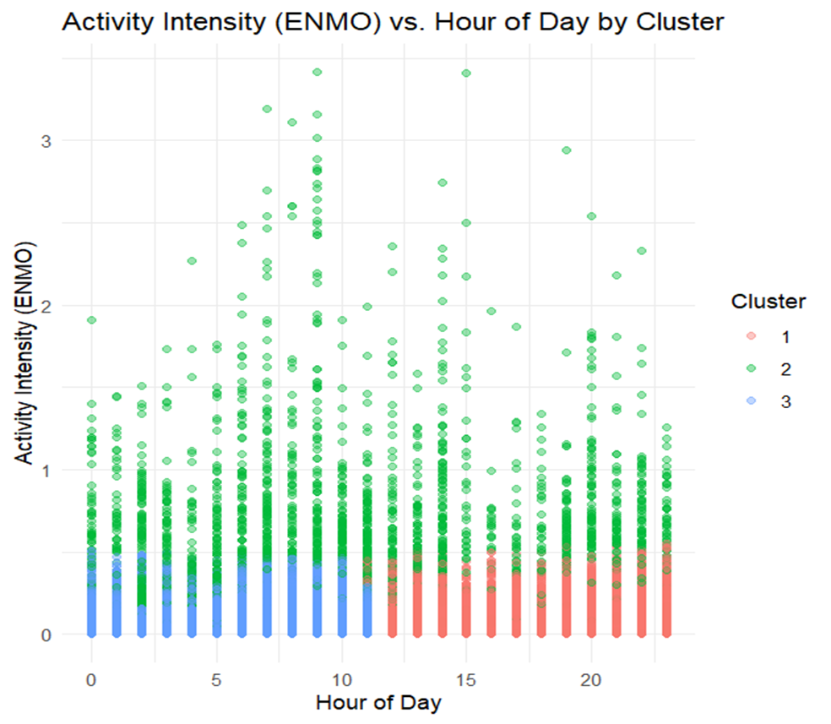
Activity Intensity (ENMO) vs. Hour of Day by Cluster
Main Focus
Cluster Segmentation
The data is divided into three groups
Cluster 2 (Green)
This group shows the highest movement levels, suggesting that people are more active and likely to engage more with social media.
Clusters 1 (Red) and 3 (Blue)
These groups show lower activity levels and represent times of rest or sleep.
Daily Activity Patterns
The scatter plot shows how activity changes throughout the day. High activity in Cluster 2 during the evening suggests that people might go to bed later than usual.
Implications for Sleep Quality
Increased movement and screen time in Cluster 2 may disrupt standard sleeping patterns.
Notes:
This slide presents a cluster plot mapping activity intensity (ENMO) against the hour of the day, divided into three clusters. Cluster 2, marked in green, shows the highest ENMO values and indicates greater social media engagement, while Clusters 1 and 3 display lower activity levels. In Cluster 2, increased evening activity suggests that late-night screen use disrupts sleep. The visualization shows daily activity patterns, providing insights for interventions to enhance sleep quality by addressing screen habits.

Slide 8
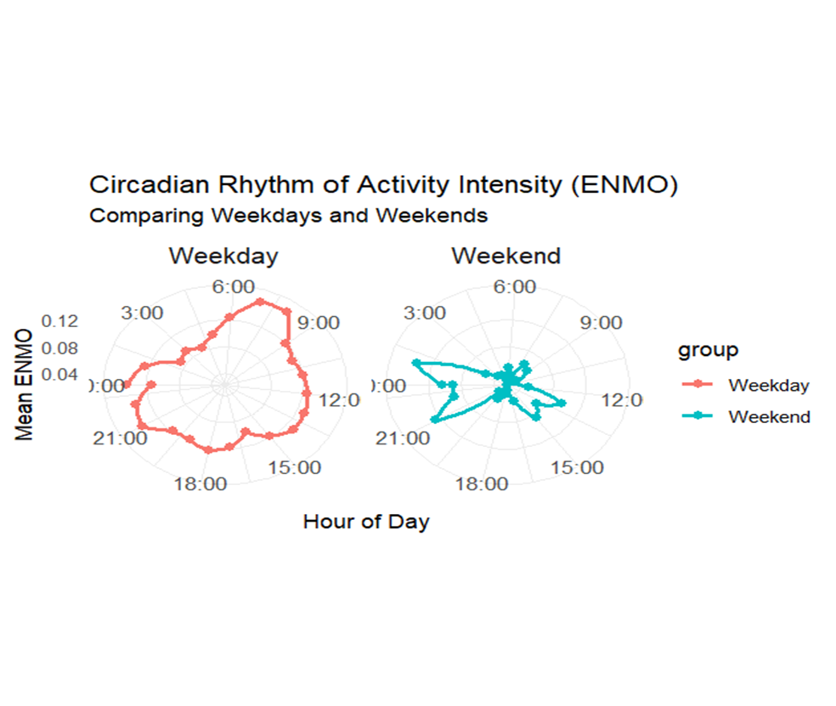
Understanding Daily Patterns and Sleep Connection
Circular Format
We show the time of day in a circle, which helps visualize natural body rhythms.
Daily Routine Changes
We highlight how activity levels change hour by hour.
We compare workweek patterns to weekend patterns.
Activity Insights
We look at average physical activity levels by hour to see when people are most awake and resting or sleeping.
Social Media and Sleep Effects
High activity levels and more light at night may mean increased screen time.
This could lead to delays in falling asleep or changes in sleep quality, especially in young adults.
Notes:
This slide features a circular graph representing daily patterns like a clock, illustrating our circadian rhythms. It shows average ENMO values for physical activity per hour that detail peaks and troughs that indicate wakefulness and sleep. A big takeaway is the contrast between weekday and weekend activity levels: weekdays show structured routines, while weekends reflect more free time and increased screen engagement. The graph also reveals how evening screen time can disrupt sleep, suggesting that young adults’ digital engagement at night may lead to later bedtimes. This visualization helps identify lifestyle changes to enhance sleep quality.

Slide 9
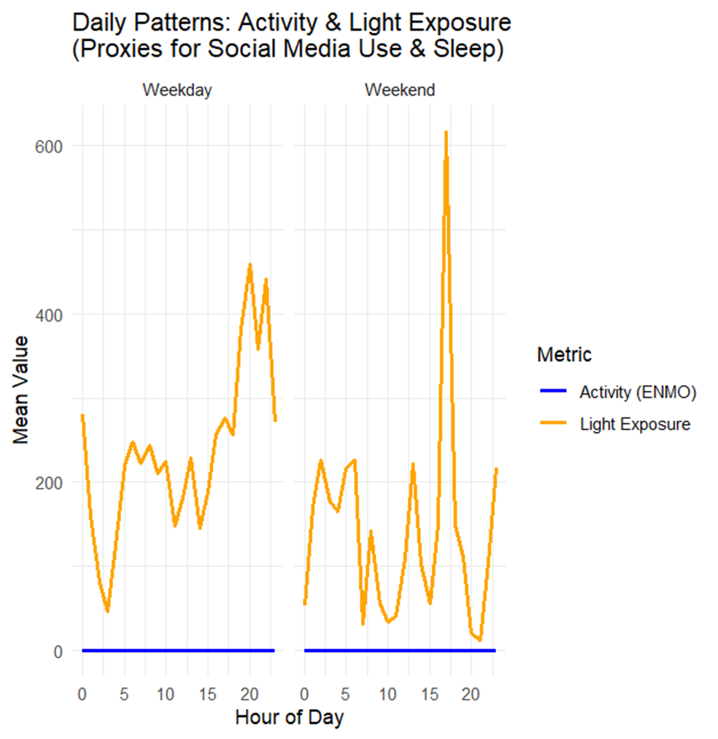
Daily Patterns: Activity & Light Exposure Daily Variation
The graph displays how activity and light exposure change throughout the day.
Activity (Blue Line)
Consistently low levels across the day.
Light Exposure (Orange Line)
It peaks around noon and is noticeably higher on weekends.
Weekday vs. Weekend
Marked differences suggest weekend habits differ from weekdays.
Implications
Trends may reflect social media use impacting sleep and overall well-being.
Notes:
This slide illustrates how physical activity and light exposure fluctuate throughout the day due to our circadian rhythms. The graph highlights that light exposure peaks midday, coinciding with maximum natural daylight. Activity levels are typically lower during weekdays with structured routines and more relaxed on weekends. Increased evening screen time can disrupt sleep cycles by raising light exposure. Recognizing these patterns is essential for improving sleep quality and developing healthier digital habits.

Slide 10
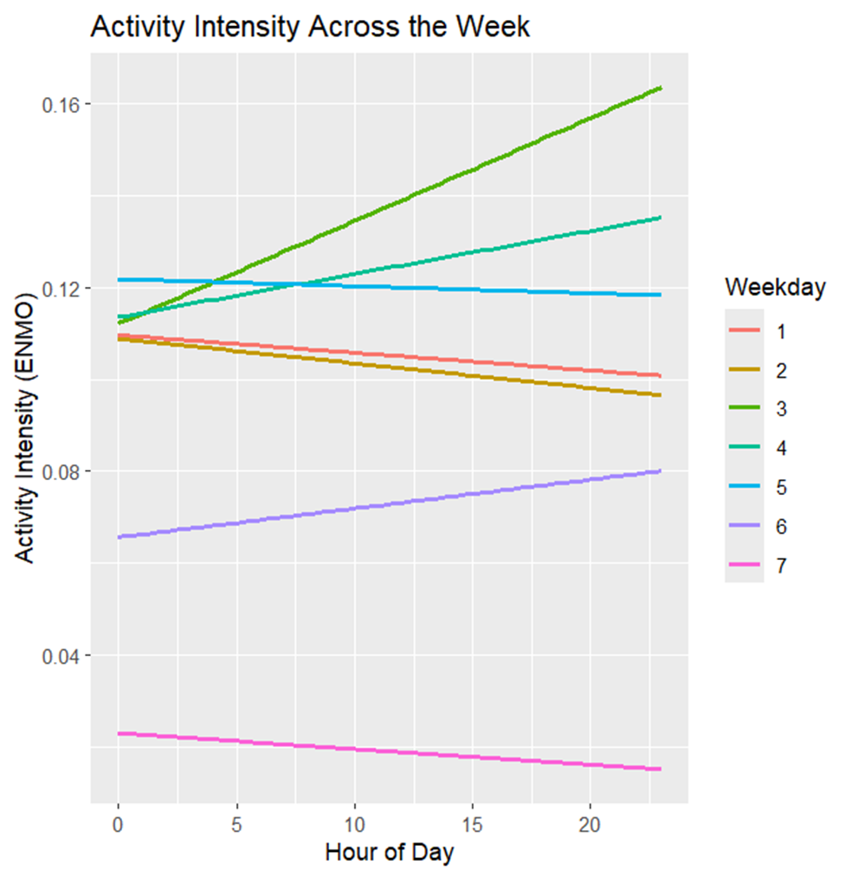
Weekly Activity Patterns & Screen Time Impact
Variations in Activity Levels (ENMO)Activity levels fluctuate throughout the week with distinct patterns for each weekday.
Daily routines (e.g., work, school) influence these differences.
Evening and Late-Night Trends
1. Some days show increased evening activity, possibly due to higher screen time or social media use.
2. Elevated late-night activity suggests that screen use could affect sleep schedules.
Early Morning Patterns
Lower activity in the early morning could mean later sleep times.
Weekday vs. Weekend Differences
Comparing weekends to weekdays shows clear differences in sleep habits and more use of technology during free time.
Next Steps for Analysis
Use statistical methods to compare activity levels. Analyze light exposure alongside ENMO to investigate if late-night activity correlates with screen time.
Notes:
This slide examines weekly activity fluctuations and their effect on screen time. ENMO data indicates higher activity during weekdays due to work and school, while weekends are more relaxed, increasing leisure screen time. Reduced morning activity on weekends may result from late nights related to screen use, impacting sleep quality. Understanding these patterns can help develop strategies to reduce screen time and improve sleep health.

Slide 11
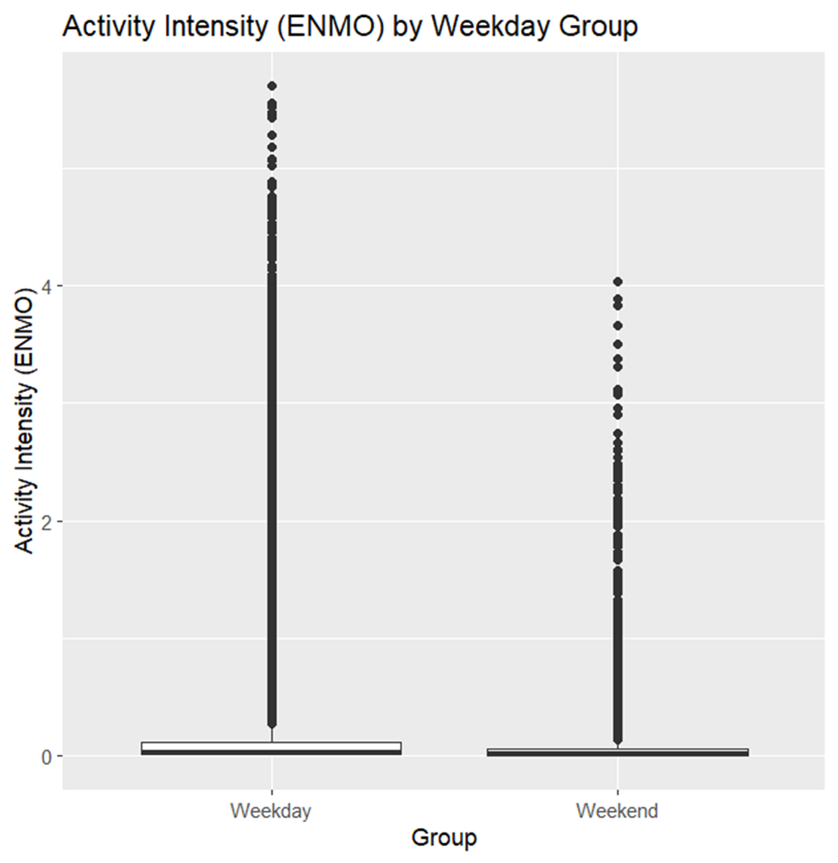
T-Test Analysis: Weekday vs. Weekend Activity Levels
Weekday Activity Average ENMO
0.1202
Weekend Activity Average ENMO
0.0638
Results
Young adults are about 0.056 points more active on weekdays.
Interpretation
1. Higher weekday activity suggests more structured routines (e.g., work/school).
2. Lower weekend activity indicates a more relaxed lifestyle.
Further Analysis
Integrate additional metrics (e.g., light exposure, sleep data) to understand better how activity differences impact sleep quality.
Notes:
This slide presents a t-test analysis of activity levels (ENMO) on weekdays versus weekends. The average ENMO is 0.1202 on weekdays and 0.0638 on weekends, showing that people are about 0.056 points more active during weekdays due to structured routines. Weekend inactivity may relate to relaxation and increased screen time. This analysis highlights the impact of daily routines on physical activity and sleep quality.

Slide 12
Conclusion & Recommendations
Major Finding
Screen time is the most important factor affecting sleep. It has the strongest connection to sleep outcomes in the model.
Model Selection
We chose a Random Forest model because it performs well and helps us understand which predictors are most important. The model focuses on screen time because research shows that how we use digital devices greatly affects our sleep quality.
Recommendations
Minimizing Screen Exposure
Implement digital curfews and use blue-light filters, especially during evening hours.
Encourage practices such as digital detox or limiting device use before bedtime.
Digital Behavior Interventions
Focus on reducing excessive screen time for young adults. Promote awareness programs that link structured digital habits with improved sleep quality.
Further Research Steps
Integrate additional metrics (such as light exposure and sleep data) to refine model predictions. Study changes over time and observe how individuals differ from one another. Explore advanced modeling techniques to deepen understanding of the interplay between digital behavior and sleep.
Notes:
Evening screen time significantly disrupts sleep. We used the Random Forest model for its effectiveness in complex analyses. Recommendations include reducing screen exposure before bed, setting digital curfews, and using blue light filters for young adults. More research on digital habits and sleep is needed for better strategies.

Slide 13
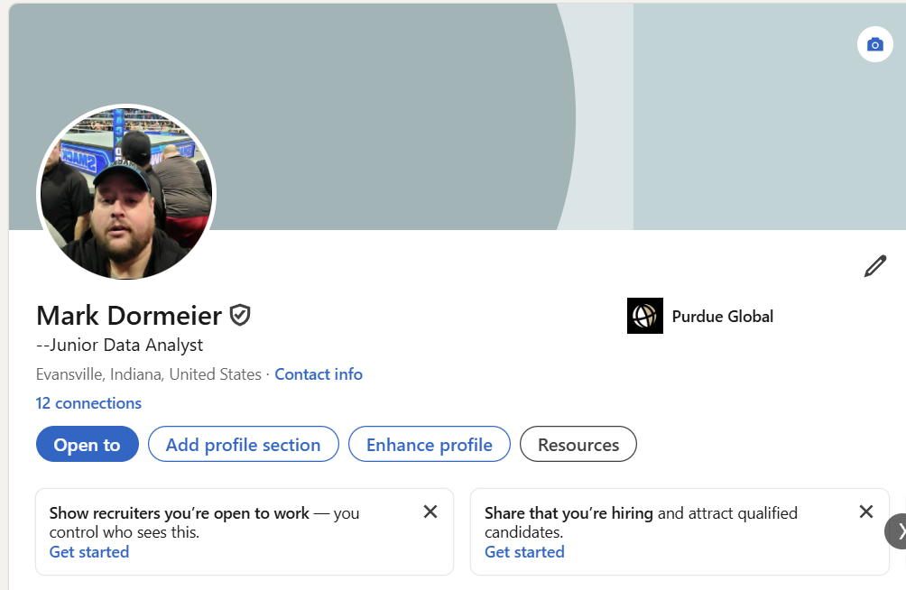
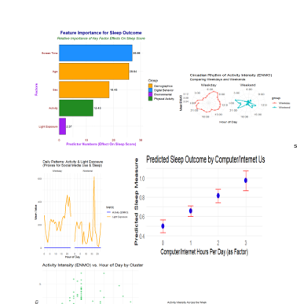
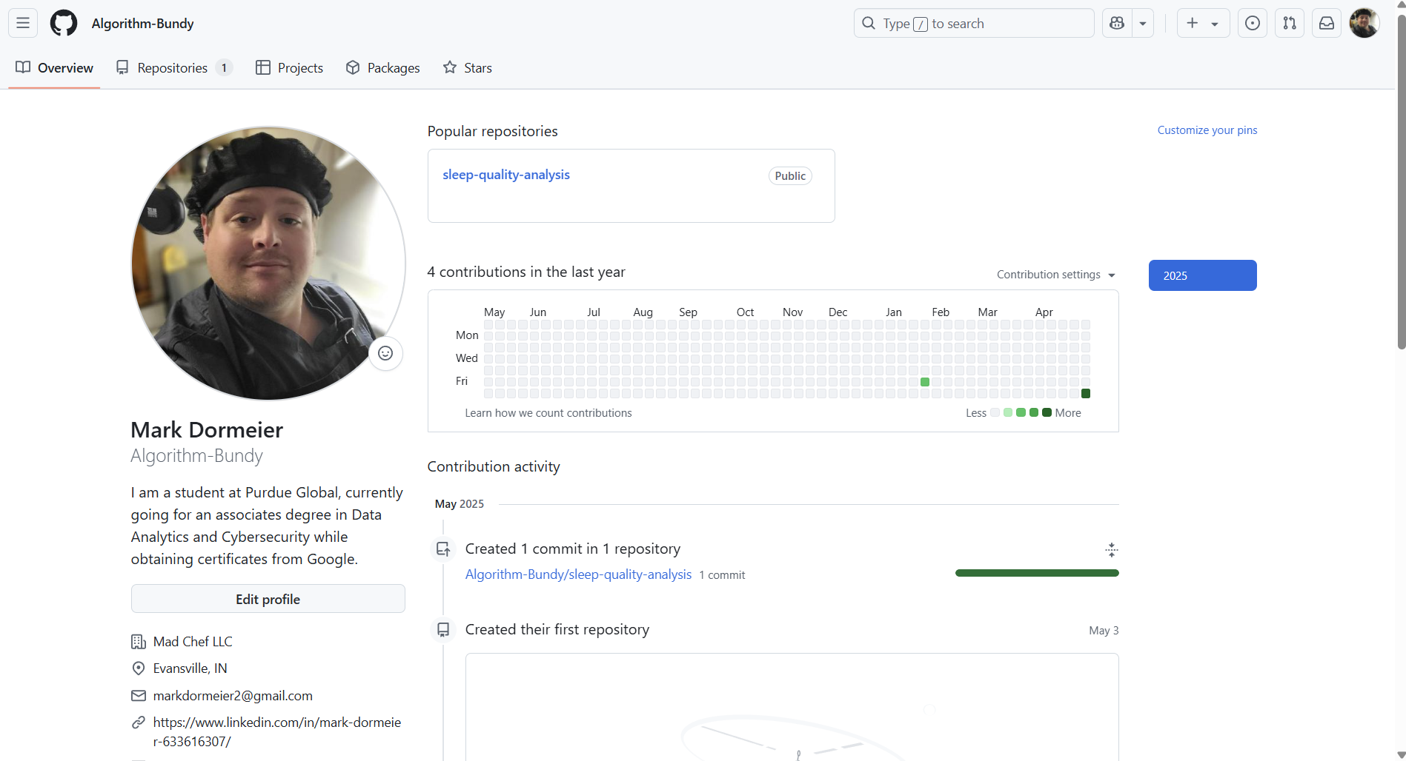
Today’s Visuals
What I Would Share Publicly
Add Me On LinkedIn
www.linkedin.com/in/mark-dormeier-633616307
Add me on GitHub
https://github.com/Algorithm-Bundy
Notes:
What I am sharing with viewers is to maintain contact for potential career opportunities.

Slide 14
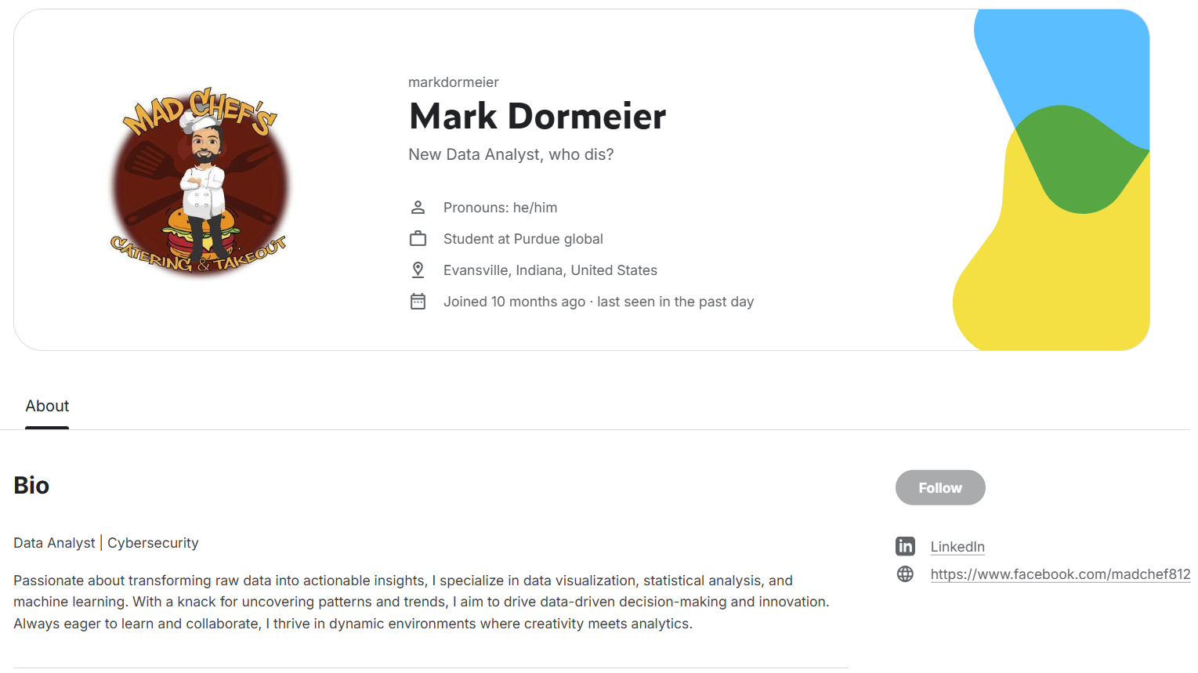





Additional Portfolio Links
Email Me
Markdormeier2@gmail.com
Markdormeier@student.PurdueGlobal.edu
Add Me On Kaggle
Mark Dormeier | Novice | Kaggle
My Public Badges & Certificates
For Cooking Ideas, Follow My Instagram
Instagram
Notes:
These are additional personal links and info on me. Thank you for your time.

Slide 15
Thank You For Your Time
Have A Great Day
Notes:
Thank you!

